Slide 1
Service Performance Centre
Notes:
Hello everyone, Before I begin, I want to sincerely thank you all for giving me the opportunity to present my skills in data analysis and visualization. I truly appreciate you taking the time to attend this presentation and review the work I’ve done using the provided dataset.
Today’s presentation is about the Service Performance Report where we will understand the business needs, lags and eventually come up to a solution of recommendations.
I will start with a short presentation; this will give a glimpse of what the actual report holds and also will come up with some problems which we will try to find a solution in the Power BI report.
After the short presentation I will play around with the Power BI report and also will go through the values the pages provide to the business. After that there is something which I want to share and can be a potential reason to enhance the engagement of the report build and my external analysis skills if the time permits.
I am happy to take question in the middle of the report demonstration, so please feel free to interrupt if you have any.
So let’s start.

Slide 2
Are You Missing These 3 Hidden Levers in Your Service Business?
Retention
Efficiency
Growth
Notes:
In any business we have 3 important pillars which needs to satisfy if someone wants to scale it. Here when it comes to Service Performance Centre it is the Retention, Efficiency and Growth. To find out the solution to all 3 we will dive into the problem. So, what’s the problem?

Slide 3

The Burning Problem
What if 20% of your revenue is at risk – and you don’t know which 20%?
What if your ‘stable’ accounts are secretly unhappy?
Let’s uncover the invisible risks hiding in the data
Notes:
The burning problem we get to see is the revenue, stable accounts and some invisible risks. How can we retain the revenue and project it much above than the previous results? Are our stable accounts actually happy? We will try to rectify all these in our report today.

Slide 4
The 3 Levers
The Churn
The Tickets
The Silent Growth
Today, we’ll try to unlock these levers – but first let’s see why they matter
Notes:
But before we dive straight into the solutions, there are other 3 important levers which a business should keep in mind. They are Churn, Tickets, and Silent Growth. I know this is something business oriented so we will answer the ‘Why’ while unlocking the matter.

Slide 5
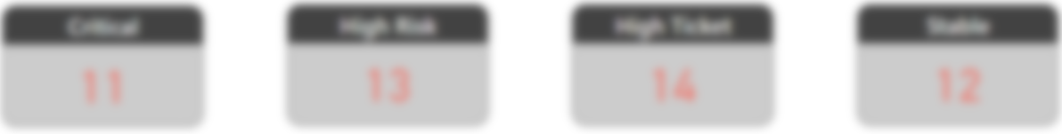
The Churn
Suppose 24 accounts are ticking. But which ones? And why?
We might think we know, but we can go wrong…
Notes:
The Churn – Suppose we have around 30 accounts and 24 out of those are on ticking stage. How do we know which accounts are actually?
By looking at the dataset, we might know, but are we sure enough to take actions?

Slide 6
The Ticket
One team is drowning in 132 tickets. Who’s rescuing them?
Notes:
Tickets – The team is getting overloaded by the tickets raised. Are we making the efficiency work well?

Slide 7
The Silent Growth
Some clients are ready to give more revenue. Are we listening?
Notes:
Growth – Some clients are actually happy. How can we sign a new deal with them?

Slide 8
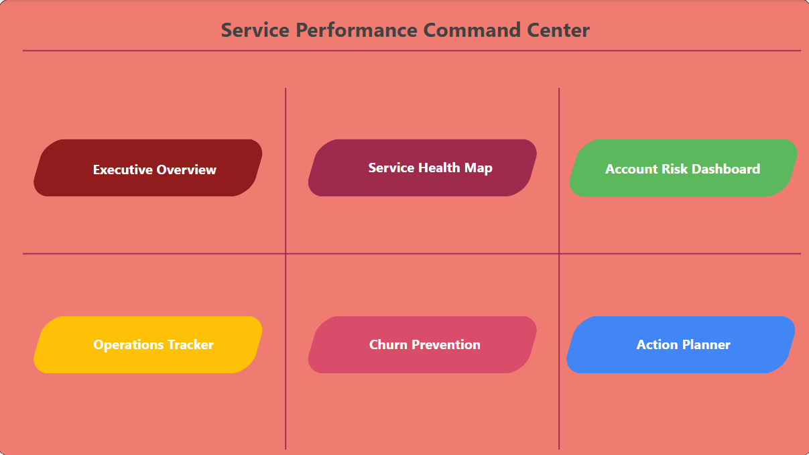
The Solution
What if you could get all these data with just 5 clicks or less?
Let me show you how
Notes:
The solution to all these has been accumulated in the Power BI report which tries to answers most of the business problem with appropriate actions and recommendations.

Slide 9
Measures

Slide 10
Action Owner
SWITCH(
[Risk Category],
"🔴 Critical", "VP of Sales",
"🟠 High Risk", "Account Manager",
"🟡 High Tickets", "Support Lead",
"N/A"
)

Slide 11
Active Services
[Active Services with End Date] + [Active Services without End Date]

Slide 12
Active Services with End Date
COUNTROWS(
FILTER(
'Service_Company_Data',
'Service_Company_Data'[Status] = "Active" && NOT ISBLANK('Service_Company_Data'[End_Date])
)
)

Slide 13
Active Services without End Date
COUNTROWS(
FILTER(
'Service_Company_Data',
'Service_Company_Data'[Status] = "Active" && ISBLANK('Service_Company_Data'[End_Date])
)
)

Slide 14
Avg Satisfaction
AVERAGE(Service_Company_Data[Customer_Satisfaction])

Slide 15
Critical Account Filter
IF(
[Risk Category] IN {"🔴 Critical", "🟠 High Risk"},
"Include",
"Exclude"
)

Slide 16
Critical Accounts
COUNTROWS(
FILTER(
SUMMARIZE(
Service_Company_Data,
Service_Company_Data[Account_Manager],
"Risk", [Risk Category] // Use the already calculated Risk Category for each AM
),
[Risk] = "🔴 Critical"
)
) + 0

Slide 17
Critical Accounts Count
COUNTROWS(FILTER(Service_Company_Data, [Risk Category] = "Critical"))

Slide 18
High Risk Accounts
COUNTROWS(
FILTER(
SUMMARIZE(
Service_Company_Data,
Service_Company_Data[Account_Manager],
"Risk", [Risk Category]
),
[Risk] = "🟠 High Risk"
)
) + 0

Slide 19
High Ticket Accounts
COUNTROWS(
FILTER(
SUMMARIZE(
Service_Company_Data,
Service_Company_Data[Account_Manager],
"Risk", [Risk Category] // Use the already calculated Risk Category for each AM
),
[Risk] = "🟡 High Tickets"
)
) + 0

Slide 20
Priority Actions
VAR Risk = [Risk Category] // Your existing measure
RETURN
SWITCH(
Risk,
"🔴 Critical", "VP review + discount",
"🟠 High Risk", "Schedule check-in",
"🟡 High Tickets", "Audit support logs",
"No action needed"
)

Slide 21
Recommended Action
SWITCH(
[Risk Category],
"🔴 Critical", "1. Review contract terms | 2. Assign senior AM",
"🟠 High Risk", "1. Schedule QBR | 2. Offer discount",
"🟡 High Tickets", "1. Audit support process | 2. Train team",
"🟢 Stable", "1. Upsell opportunity | 2. Request referral"
)

Slide 22
Risk Category
VAR AvgProb = AVERAGE(Service_Company_Data[Renewal_Probability])
VAR TicketsPerService = [Tickets per Active Service] // This is a measure already
VAR HighTicketThreshold = 100 // Your defined threshold
RETURN
SWITCH(
TRUE(),
AND(AvgProb < 0.5, TicketsPerService > HighTicketThreshold), "🔴 Critical",
AvgProb < 0.5, "🟠 High Risk",
TicketsPerService > HighTicketThreshold, "🟡 High Tickets",
"🟢 Stable"
)

Slide 23
Stable Accounts
COUNTROWS(
FILTER(
SUMMARIZE(
Service_Company_Data,
Service_Company_Data[Account_Manager],
"Risk", [Risk Category]
),
[Risk] = "🟢 Stable"
)
) + 0

Slide 24
Tickets per 1M Revenue
DIVIDE(
SUM(Service_Company_Data[Support_Tickets]),
[Total Revenue] / 1000000,
0
)

Slide 25
Tickets per Active Service
DIVIDE(
SUM(Service_Company_Data[Support_Tickets]),
[Active Services],
0
)

Slide 26
Total Revenue
SUM(Service_Company_Data[Monthly_Cost])

Slide 27
Verified Total Accounts
COUNTROWS(
SUMMARIZE(
Service_Company_Data,
Service_Company_Data[Account_Manager]
)
)

Slide 28
Calculated Columns

Slide 29
Auto Renewal Icon
VAR IsAutoRenewal = Service_Company_Data[Is_Auto_Renewal]
RETURN
SWITCH(
TRUE(),
IsAutoRenewal = TRUE(), "✅", // Green check
IsAutoRenewal = FALSE(), "❌", // Red X
"⏺️" // Gray circle for blanks/unknown
)

Slide 30
Churn Risk Flag
SWITCH(
TRUE(),
// Highest Priority: Paused or Cancelled
'Service_Company_Data'[Status] = "Paused" || 'Service_Company_Data'[Status] = "Cancelled", "Review Terms",
// Second Priority: Active and End Date is not blank
'Service_Company_Data'[Status] = "Active" && NOT ISBLANK('Service_Company_Data'[End_Date]), "Active / Contract Ending Soon",
// Third Priority: Completed and End Date is blank (potential data issue)
'Service_Company_Data'[Status] = "Completed" && ISBLANK('Service_Company_Data'[End_Date]), "Completed (Possible Data Anomaly)",
// Default: All other cases (e.g., Active without End Date, or other statuses not explicitly handled)
"Active Status / Contract Ending"
)

